Slide 1


Atliq Hardware’s Consumer Goods Ad_Hoc insights
Presented By – Yatesh Patil
SQL Project Challenge

Slide 2


Background :
Atliq Hardware’s (imaginary company) is one of the leading computer hardware producers in India and well expanded in other countries too.
Problem :
The management found out that they do not get enough insights to make quick and smart data-informed decisions. For this purpose, they want to expand their data analytics team and thus they want to hire someone who is good in both technical and soft skills. Therefore, they conducted SQL challenge.
Task :
I am one of those applicant who has taken this SQL challenge and I need to give insights on 10 ad-hoc request’s which has been asked by the hiring manager.

Slide 3
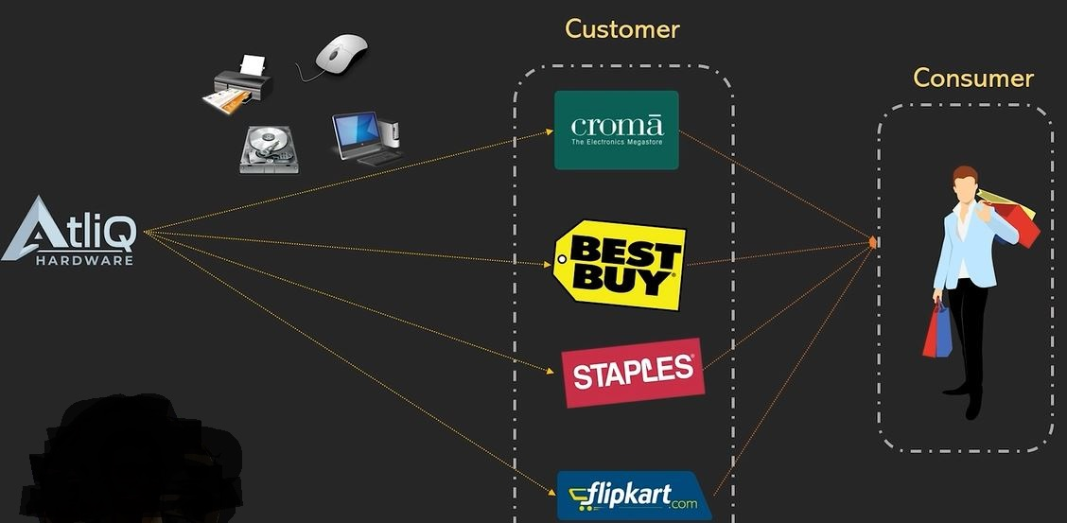
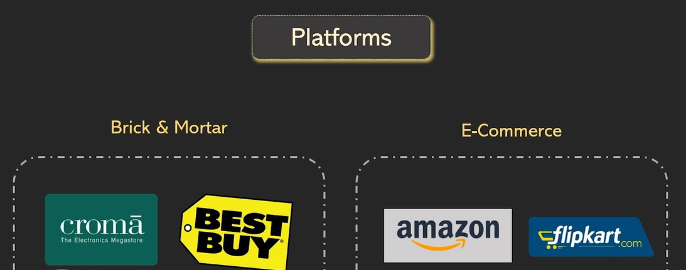
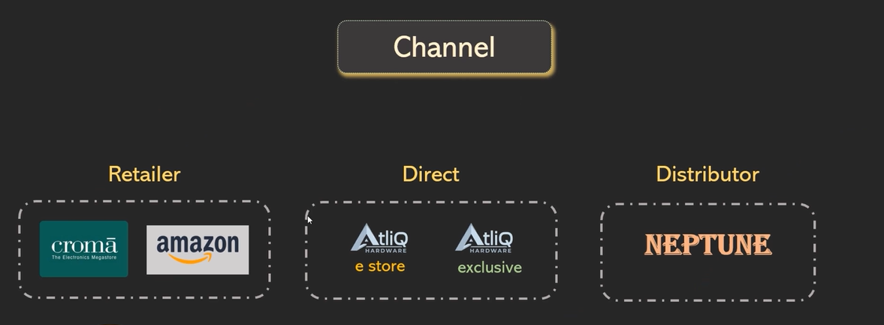
Understanding Atliq Hardware’s Business Model
All images credit – Codebasics SQL Beginner to Advanced For Data Professionals course
Link: https://codebasics.io/courses/sql-beginner-to-advanced-for-data-professionals

Slide 4

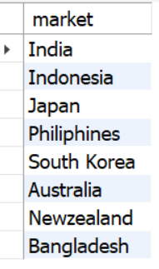
Provide the list of markets in which customer "Atliq Exclusive" operates its business in the APAC region.
Request 1:
Output:

Slide 5
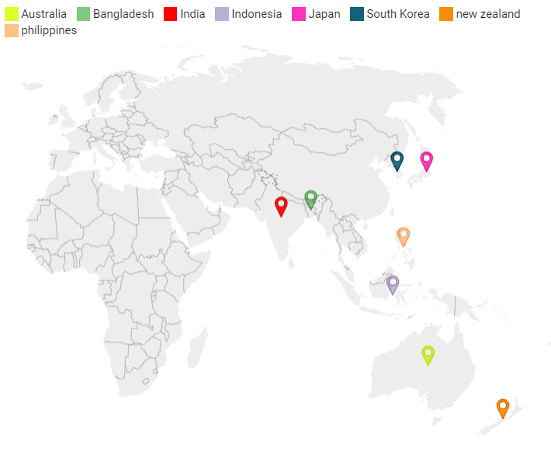
Conversion of output to visual
Insights
Our customer "Atliq Exclusive" operates its business in the APAC region in 8 markets

Slide 6
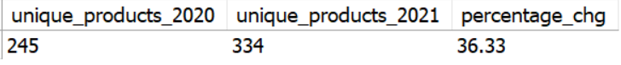
What is the percentage of unique product increase in 2021 vs 2020? The final output contains these fields unique_products_2020, unique_products_2021, percentage_chg
Request 2:
Output:

Slide 7
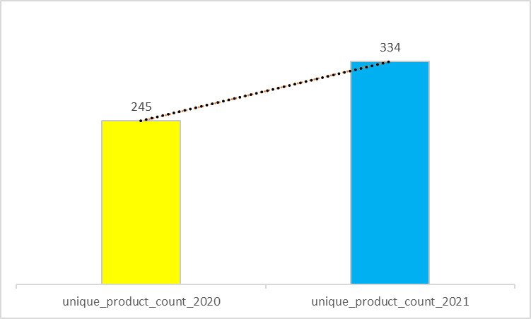
Conversion of output to visual
36.33
Insights
The number of unique products in fiscal year 2020 were 245 and in 2021 it has been increased by the count of 89 which is 36.33% more than what was in the previous year.
This shows that our products are well accepted by market, and we can further introduce new products in future.

Slide 8
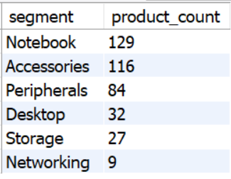
Provide a report with all the unique product counts for each segment and sort them in descending order of product counts. The final output contains 2 fields segment and product_count
Request 3:
Output:

Slide 9
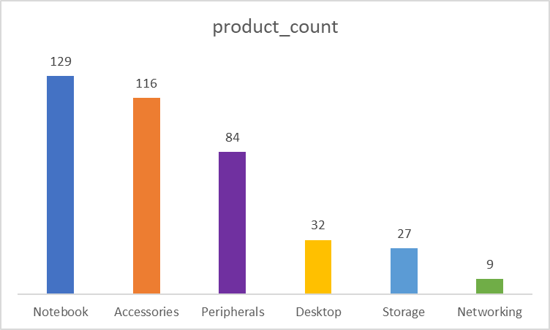
Conversion of output to visual
Insights
Notebook segment has the most no of unique products while networking has the least.
We need to increase our products in Desktop, Storage and Networking segments as the number of unique products in this sections are very less which as of now which might be even affecting our business revenue.

Slide 10
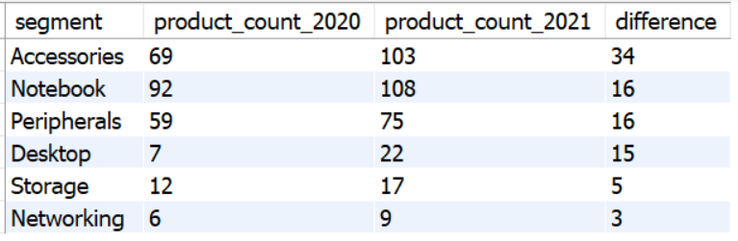
Which segment had the most increase in unique products in 2021 vs 2020? The final output contains these fields segment,product_count_2020,product_count_2021,difference
Request 4:
Output:

Slide 11
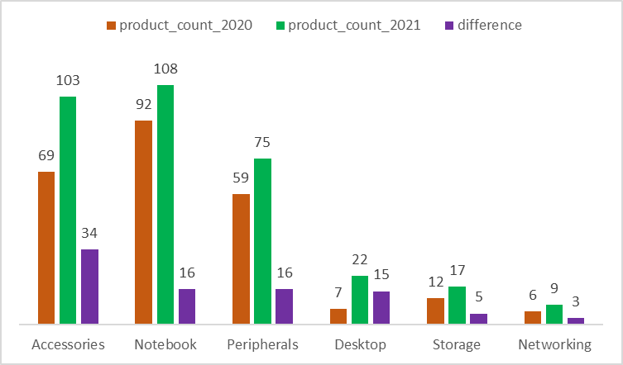
Conversion of output to visual
Insights
Accessories segment had the most rise in unique products in 2021 as compared to all other segments from 2020. The least increase is in Networking segment.
This suggests that demand for different accessories is more as compared to other segments.

Slide 12
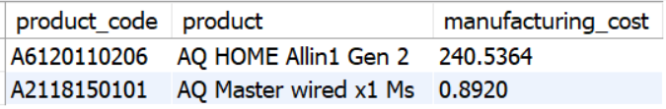
Get the products that have the highest and lowest manufacturing costs. The final output should contain these fields product_code, product, manufacturing_cost
Request 5:
Output:

Slide 13
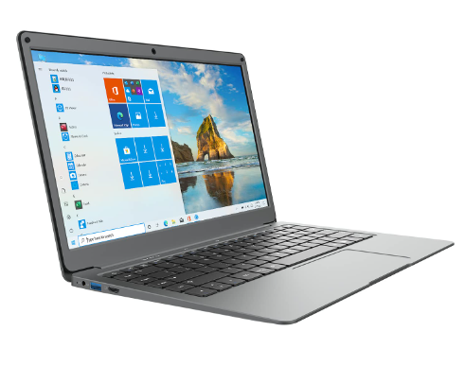

Conversion of output to visual
AQ HOME Allin1 Gen 2
Price $240.54
AQ Master wired x1 Ms Price $0.89
Insights
Product AQ HOME Allin1 Gen 2 which belongs to ‘Personal Desktop’ category has the highest manufacturing cost .
AQ Master wired x1 Ms of the ‘Mouse’ category has the least.

Slide 14
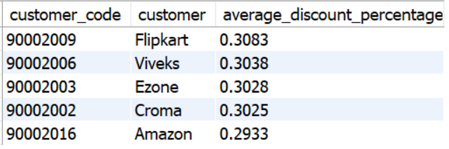
Generate a report which contains the top 5 customers who received an average high pre_invoice_discount_pct for the fiscal year 2021 and in the Indian market. The final output contains these fields customer_code,customer, average_discount_percentage.
Request 6:
Output:

Slide 15
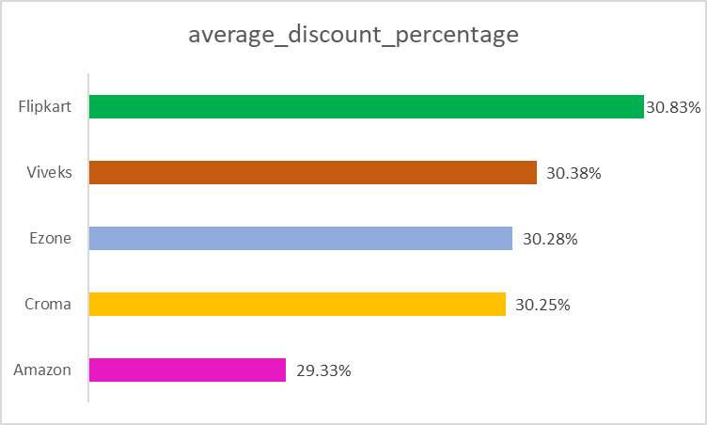
Conversion of output to visual
Insights
We almost gave same discount to all the top 5 customers in the Indian market for the fiscal year 2021.
Flipkart top’s the list with 30.83% average discount whereas Amazon received the least average discount among our top 5 customers for Indian market.

Slide 16
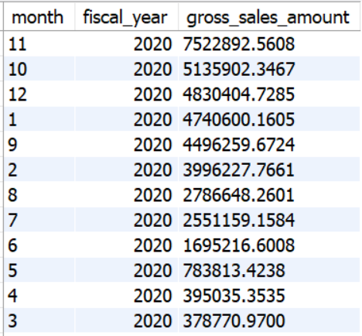
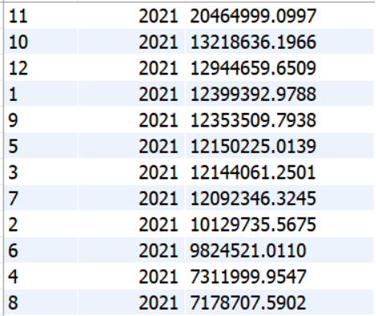
Get the complete report of the Gross sales amount for the customer “Atliq Exclusive” for each month . This analysis helps to get an idea of low and high-performing months and take strategic decisions. The final report should contain these columns Month,year,Gross sales amount
Request 7:
Output:

Slide 17
Conversion of output to visual
Insights
Gross sales amount for “Atliq Exclusive” was highest in November 2021 accounting for 20.465 Million’s and lowest in March 2020 accounting for 0.379 Millions.
In general, for Atliq Hardware the market in India is very high as compared to other countries and thus the gross sales is in the month of November is seen to be higher for both fiscal year as it is Diwali time in India and people prefer buying new products during those times.
Overall, the sales for fiscal year 2020 is very low as compared to fiscal year 2021 because majority of the countries were hit by covid, and it affected our business is well.
After covid we have recovered pretty well as the gross sales number are high for fiscal year 2021.

Slide 18
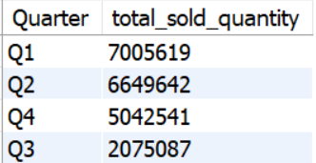
In which quarter of 2020, got the maximum total_sold_quantity? The final output contains Quarter, total_sold_quantity sorted by the total_sold_quantity
Request 8:
Output:

Slide 19
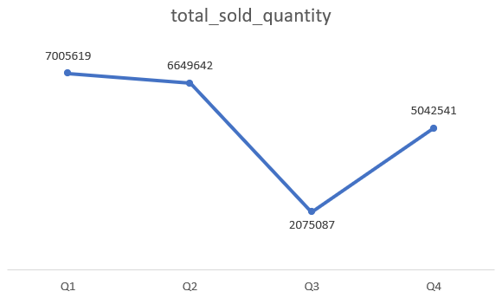
Conversion of output to visual
Insights
Quarter 1 which consists of months September, October, November had the highest sold quantity for the fiscal_year 2020
The reason for high sales during this period is again same as said previously as it is festival time in India.
The sales dropped down in Q3 of 2020 which consists of months March, April, May as majority of the nations went under lockdown during these times as Covid hit entire world.

Slide 20
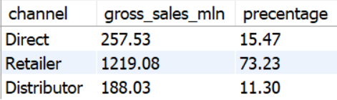
Which channel helped to bring more gross sales in the fiscal year 2021 and the percentage of contribution? The final output contains these fields channel,gross_sales_mln,percentage
Request 9:
Output:
Distribution of Channels

Slide 21
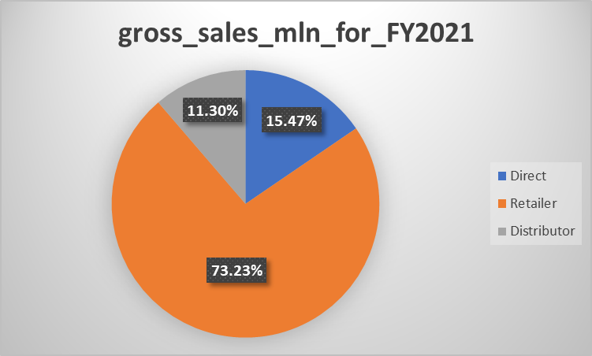
Conversion of output to visual
Insights
Retailer channel has the highest contribution followed by Direct channel for the fiscal year 2021.
Distributor channel had the least contribution for that fiscal year.

Slide 22
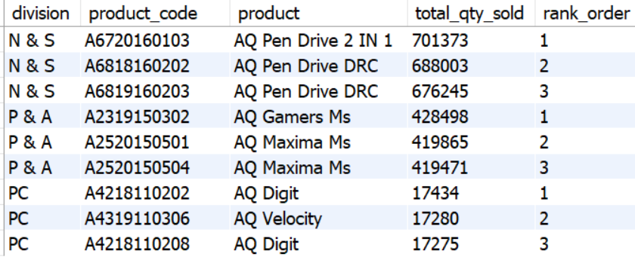
Get the Top 3 products in each division that have a high total_sold_quantity in the fiscal_year 2021? The final output contains these fields division,product_code,product, total_qty_sold,rank_order
Request 10:
Output:

Slide 23
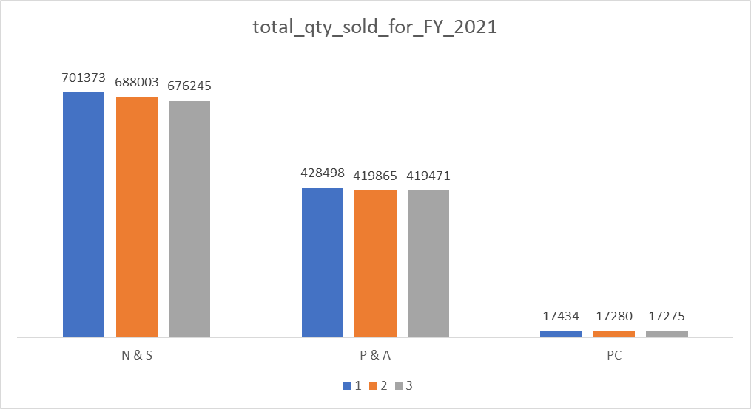
Conversion of output to visual
Insights
The top 3 sold products for FY2021 belonging to division N&S are all pen drives with variation in DRC as plus and premium.
The top 3 sold products for FY2021 belonging to division P&A are all Mouse with variation in Maxima Ms as standard1 and Plus 2.
The top 3 sold products for FY2021 belonging to division PC all personal laptops with variation in AQ Digit as standard blue and Premium Misty Green.

Slide 24
Thank You…
Happy Learning

